Slide 1


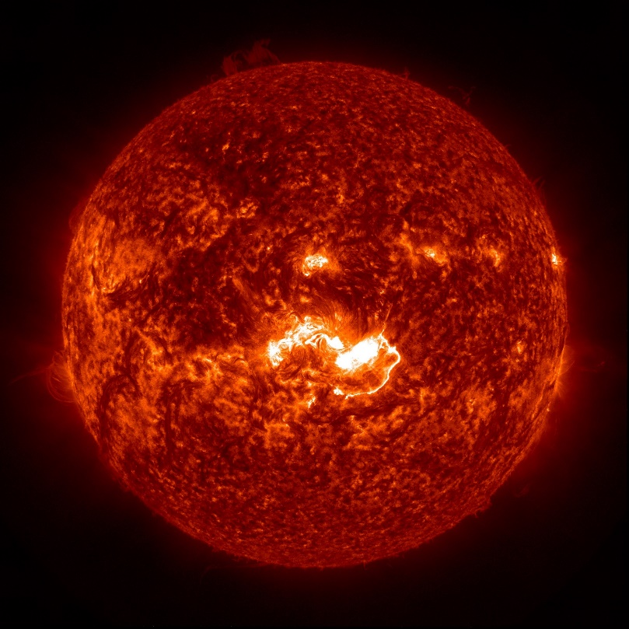
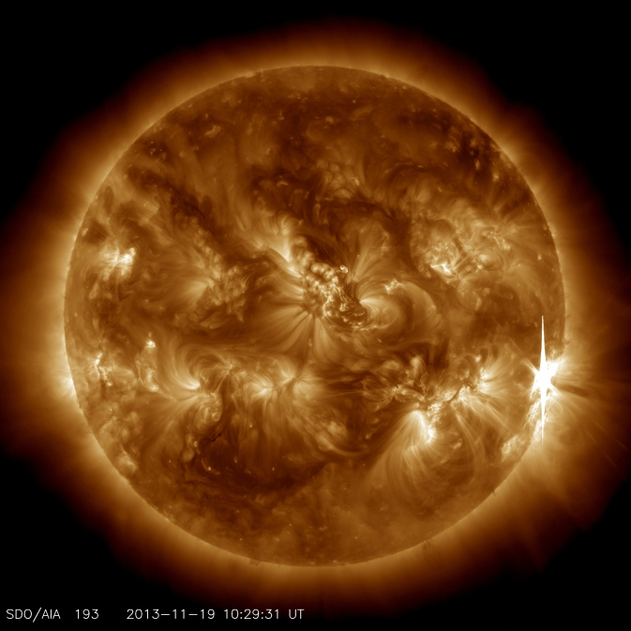
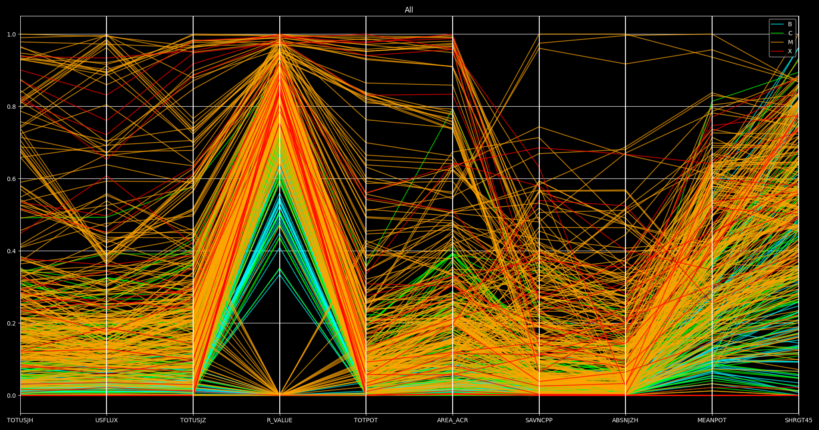
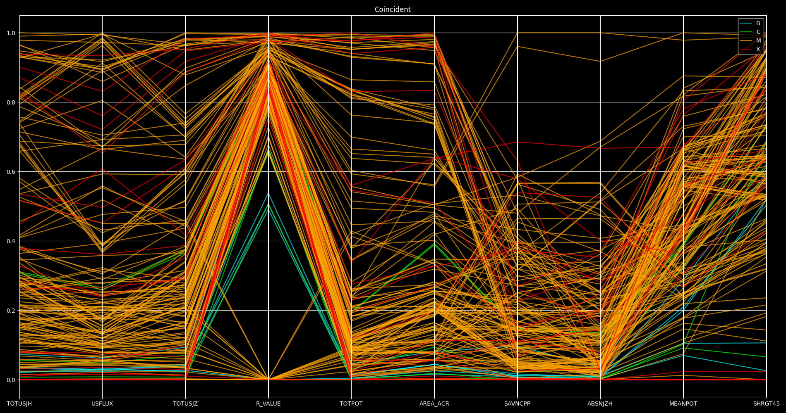
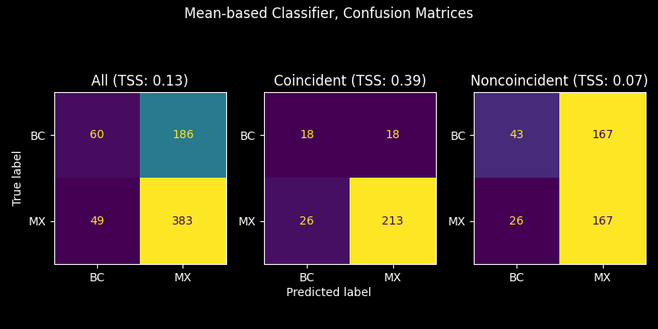
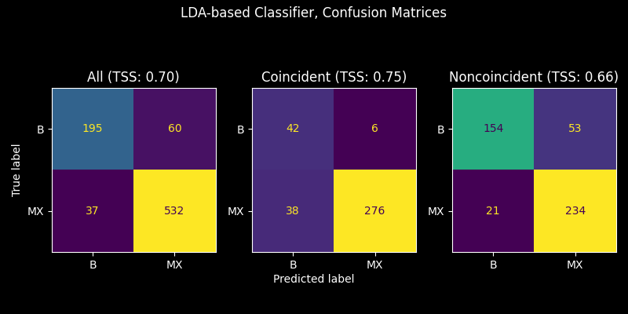
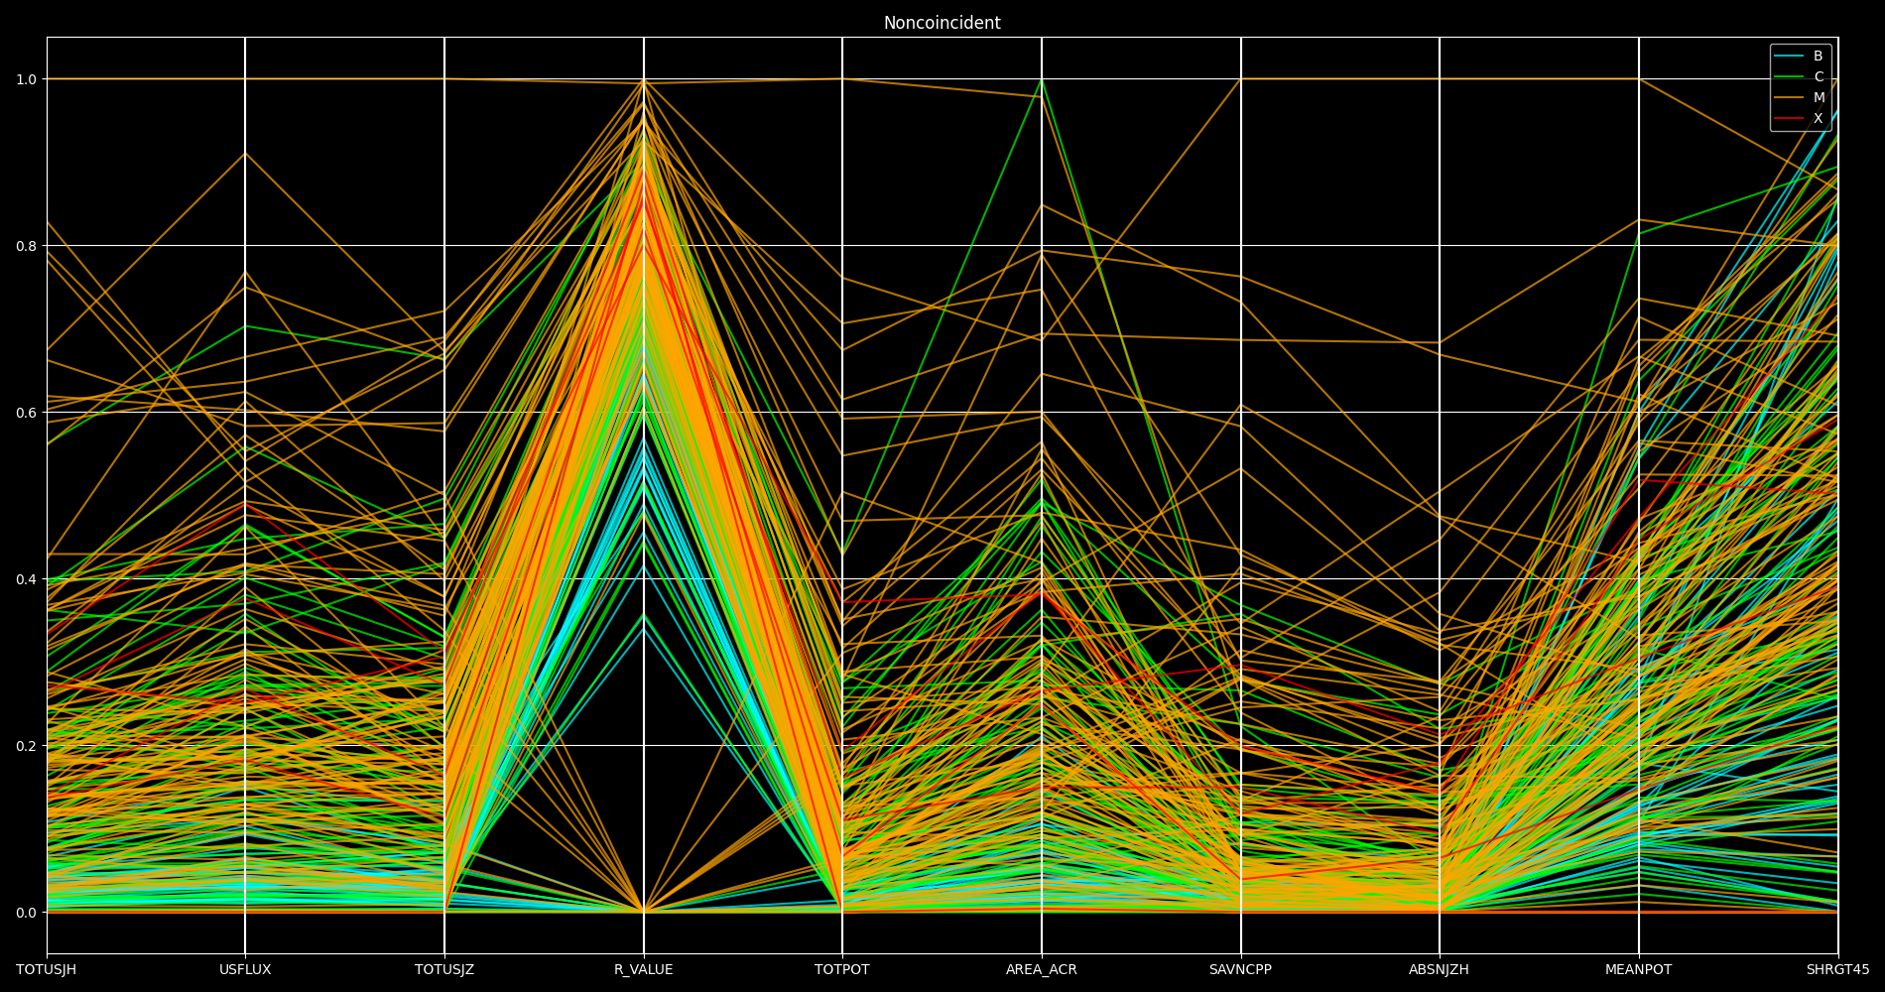
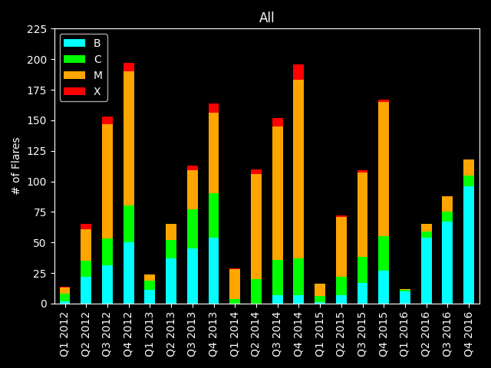
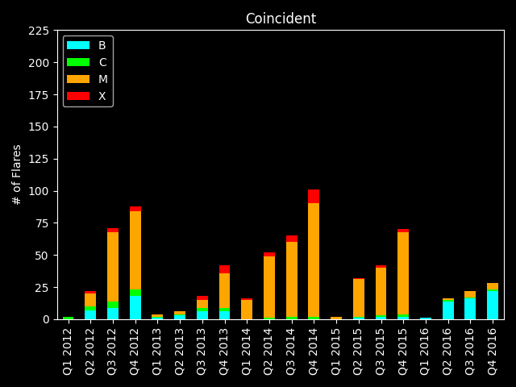
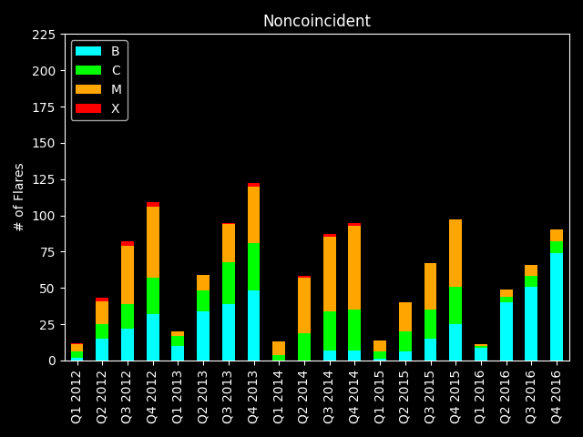
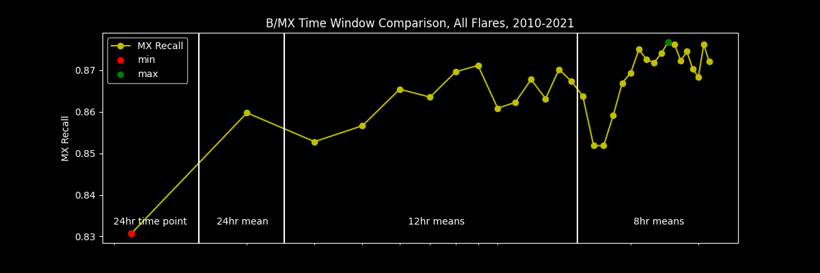
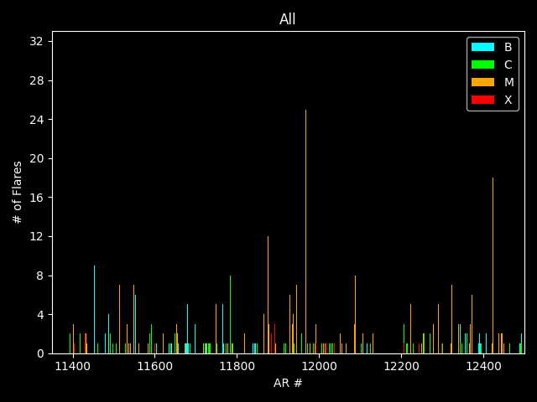
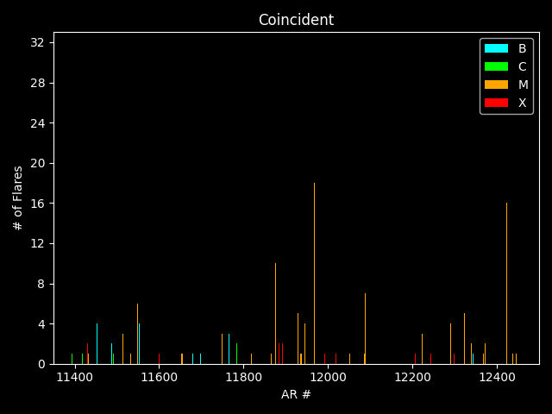
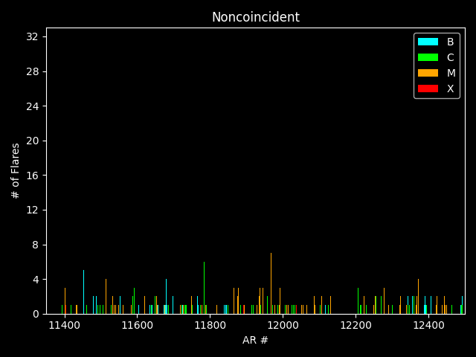
Active Region Coincidence Considerations in Solar Flare Prediction: Solar Cycle 24, Peak Years Study
Christian W. Hall¹, Timothy S. Newman¹, Talwinder Singh², Nikolai Pogorelov²
X1.6 Class Solar Flare of January 2014 (taken from [1])
University of Alabama in Huntsville
¹Department of Computer Science
²Center for Space Plasma and Aeronomic Research
Huntsville, AL, 35899 USA
X1.0 Class Solar Flare of November 2013 (taken from [2])
Abstract
Mean-based Classification
(BC vs. MX, 2013-2014)
LDA-based Classification
(B vs. MX, 2012-2016)
SHARP Parameter Visualization (Parallel Coordinates)
In this work, active region (AR) coincidence effects on Spaceweather HMI Active Region Patch (SHARP) parameters (which may be valuable for flare prediction) are considered. Focus is on the peak years of Solar Cycle 24. (Two sub-studies are reported here, one for 2013-2014 and the other for 2012-2016.) Here, coincidence refers to the occurrence of at least two solar flares within the same active region within 24 hours of one another. We term any flare that occurs in an AR, R, less than 24 hours later than another flare that also occurred in region R a coincident flare; we term any other flare a non-coincident flare.
Observations of SHARP parameter differences for coincident versus non-coincident B, C, M, and X class flares for these years are reported in this work, especially via consideration of time series values for the 24 hours prior to flare onset. Onset times were determined from a catalog of B, C, M, and X class solar flares for the time period, which included their start time and a label of their X-ray class. Several SHARP parameters exhibit notable differences; in particular, the M/X class parameter values for coincident flares often diverge from the ones for non-coincident flares.
The effect of these differences on one flare prediction mode (i.e., prediction of an M/X flare based on 24-hour time series values for key SHARP parameters) is also considered here using thresholding-based predictors. Prediction success metrics are key reports.
A key finding is that methods for prediction of M/X class coincident flares are likely to be divergent from ones for prediction of M/X class non-coincident flares.
Coincidence | B-Class | C-Class | M-Class | X-Class | Total
All | 119 | 127 | 398 | 34 | 678
Coincident | 24 | 12 | 214 | 25 | 275
Noncoincident | 95 | 115 | 184 | 9 | 403
Coincidence | B-Class | M-Class | X-Class | Total
All | 255 | 533 | 36 | 824
Coincident | 48 | 287 | 27 | 362
Noncoincident | 207 | 246 | 9 | 462
Flare Counts
Flare Counts
Coincidence | Flare Class | Precision | Recall | F1-Score | Accuracy
All | BC | 0.55 | 0.24 | 0.34 | 0.65
 | MX | 0.67 | 0.89 | 0.77
Coincident | BC | 0.41 | 0.50 | 0.45 | 0.84
 | MX | 0.92 | 0.89 | 0.91
Noncoincident | BC | 0.62 | 0.20 | 0.31 | 0.52
 | MX | 0.50 | 0.87 | 0.46
Coincidence | Flare Class | Precision | Recall | F1-Score | Accuracy
All | B | 0.84 | 0.76 | 0.80 | 0.88
 | MX | 0.90 | 0.93 | 0.92
Coincident | B | 0.53 | 0.88 | 0.66 | 0.88
 | MX | 0.98 | 0.92 | 0.93
Noncoincident | B | 0.88 | 0.74 | 0.81 | 0.84
 | MX | 0.82 | 0.88 | 0.86
Methodology
Work examines two time periods: 2013-2014 and 2012-2016, both centered at solar maximum.
10 SHARP parameters are obtained by taking the timepoint 24 hours before flare peak time.
Flares with missing values for any parameter are excluded.
C-class flares excluded in 2012-2016 data, as in [3]. (C classification is complex!)
Classification Report
Classification Report
Study 1
Mean-based Classifier (BC vs. MX, 2013-2014)
(1) Classifier examines one parameter of a candidate flare, then (2) uses thresholding to classify. Specifically:
If the parameter is less than (µ_{M} - σ_{M}) for that parameter: classify as BC;
Otherwise: classify as MX.
Majority vote of the ten classifications → final classification for flare.
Study 2
Linear Discriminant Analysis (LDA)-based Classifier (B vs. MX, 2012-2016)
Uses Fisher’s LDA as a classifier.
Cross-validation via Leave One Out testing.
The midpoint between each class mean is calculated, and each candidate flare has its SHARP parameters projected into the 1D LDA space:
If projected data point is less than the midpoint: classify as B;
Otherwise: classify as MX.
BCMX Flare Census, 2012-2016
Future Work
Conclusion
More recent work by us: choosing the particular time in which the flare’s SHARP parameters are drawn from has a significant impact on its classification.
Timepoints and averages over time windows were considered.
Coincident flares seem to tend to be more energetic than non-coincident flares.
As a result, these coincident flares seem to be easier to classify than those flares that are noncoincident.
Thus, a two-step process for flare classification follows, where different classifiers are used depending on whether the candidate flare is a coincident flare or a non-coincident flare.
Acknowledgement
Breakdown of Flares by Yearly Quarter
Funding for this work was provided by a NASA grant to UAH.
References
NASA's Scientific Visualization Studio, Feb. 11, 2014, https://svs.gsfc.nasa.gov/4065.
NASA/SDO, Nov. 19, 2013, https://www.nasa.gov/content/goddard/x-class-solar-flare-nov-19/.
S. Sinha, et al. “A Comparative Analysis of Machine-learning Models for Solar Flare Forecasting: Identifying High-performing Active Region Flare Indicators,” Ap. J. 935:45 (2022)
Breakdown of Flares by Active Region
Take-away: choosing the average of the time period about 12 hours before the flare peak time give better classification results.

